Slide 1

Basic Shading
CS 296: Data Structures Honors Section Geometric Data Structures for Computer Graphics
UNIVERSITY OF ILLINOIS AT URBANA-CHAMPAIGN
Eric Shaffer

Slide 2
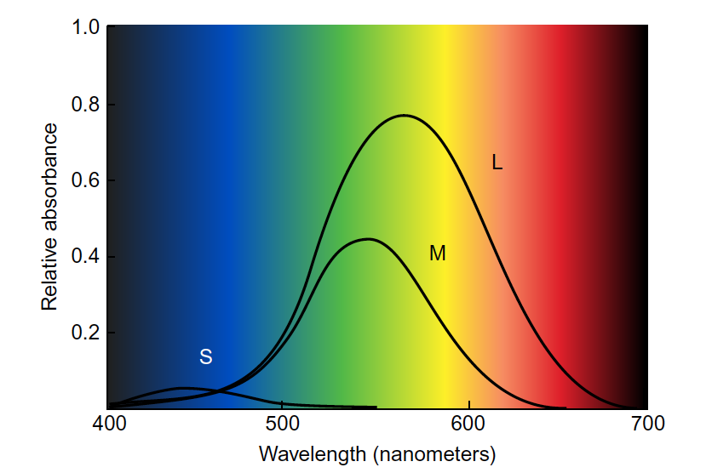
Quick Color Theory: Cone Response

Slide 3
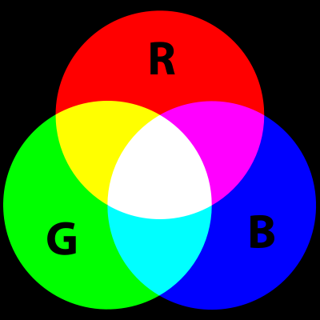
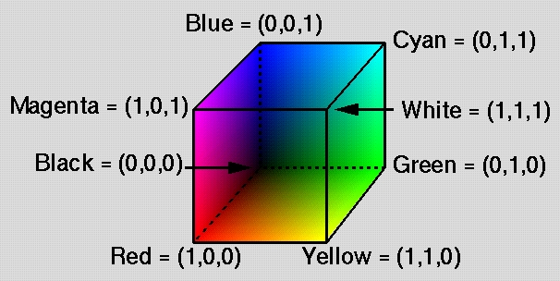
RGB Additive Color
Red, Green, Blue
We will use convention that each channel is in [0.0, 1.0]
Color model used in luminous displays (CRT, plasma, LCD)
Physically linear
Perceptually logarithmic
Additive
Designed to stimulate each kind of cone

Slide 4
Illumination and Reflection
Illumination: light that arrives at object surfaces
Direct: Light arrives uninterrupted from a light (local)
Indirect: Light arrives after reflecting off other surfaces (global)

Slide 5
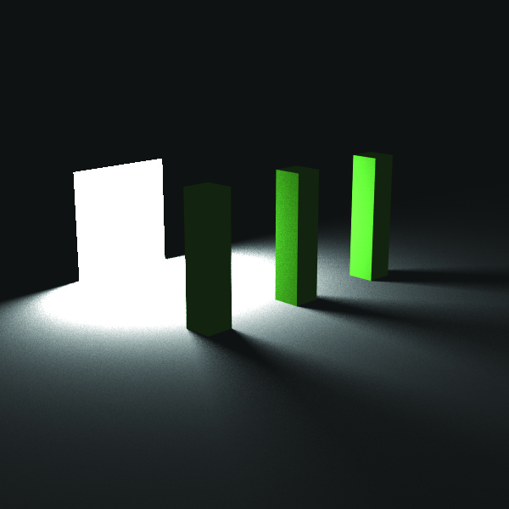
Lights
We will start with non-physical lights
Ambient
Directional
Point
All have:
a color c_{l}
What do directional and point have that ambient doesn’t?
What does point have that the other two don’t?

Slide 6

Ambient Light
Models indirect diffuse illumination
Not even close to physically correct
Isotropic 3D radiance field
Just a color C
No direction or position
“A good candidate for most boring image in the book”

Slide 7

Directional Lights
Light rays are parallel
Approximation to Sun’s rays hitting the Earth
Incident radiance does not vary with position
Color and Direction
l
n
specified dir
ection
θ
l
l
l
(b)
l
incoming light
θ
l
(a)
n

Slide 8
Point Lights
Have a position
Have no surface area
Allow us to model distance attenuation
Multiply color by the inverse of the square of the distance
You can choose not to – can sometimes look better if you don’t do it

Slide 9
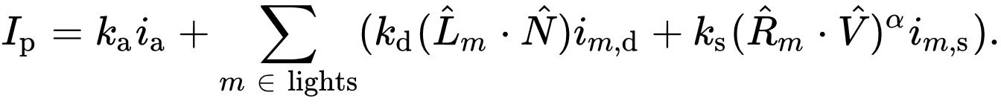
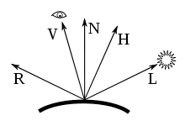
Phong Reflection Model
K = Material reflectance, an rgb color
I = Light, an rgb color
L = Vector from a point to the light
N = Normal vector, orthogonal to surface at the point
R = Reflection vector
V = Vector to the viewer (the reverse of the primary ray) All vectors are unit length

Slide 10
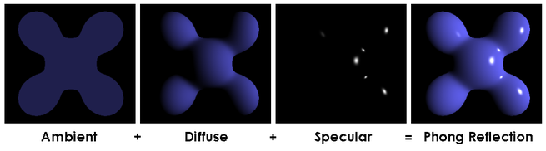
Phong Reflection Model
K = Material reflectance, an rgb color
I = Light, an rgb color
L = Vector from a point to the light
N = Normal vector, orthogonal to surface at the point
R = Reflection vector
V = Vector to the viewer (the reverse of the primary ray) All vectors are unit length
Ambient Term
Diffuse Term
Specular Term

Slide 11
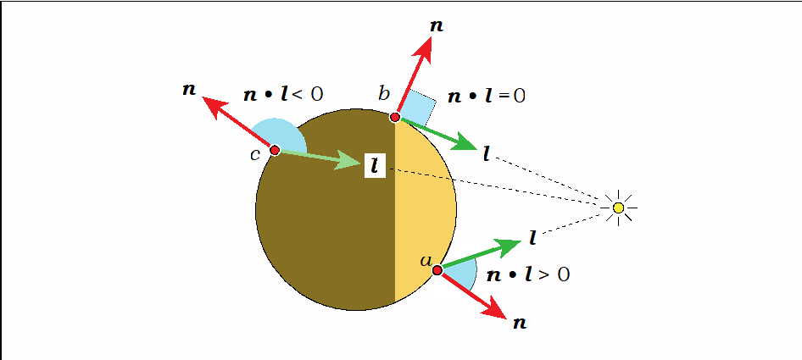
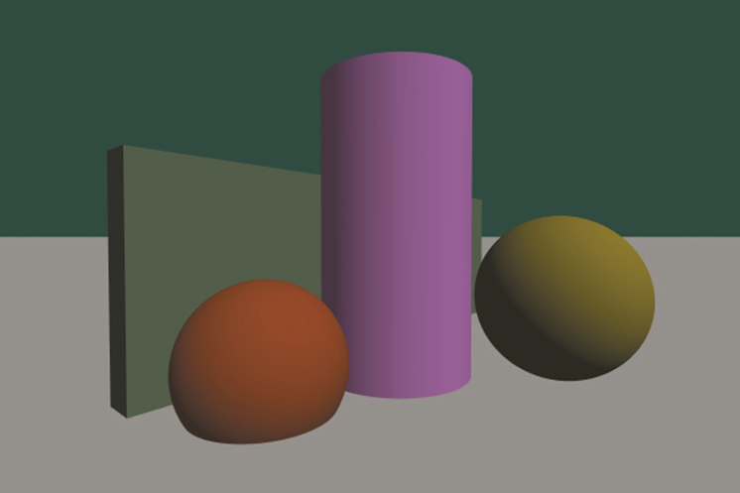
Phong Reflection Model
Diffuse term models reflection off a rough surface
Lambertian reflection
Dot product of N and L tells you how directly light hits surface
Intensity of reflected light diminishes as the angle increases

Slide 12
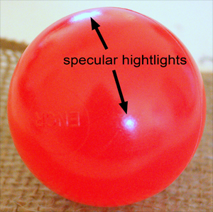
Specular Reflection
Perfect specular reflection
Light is reflected in the single direction r
…the mirror reflection direction
Glossy specular reflection
Scattering clustered around mirror reflection direction

Slide 13
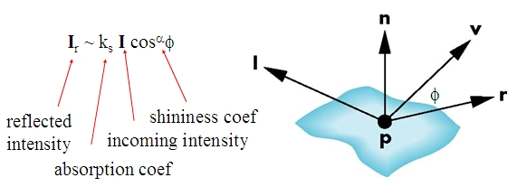
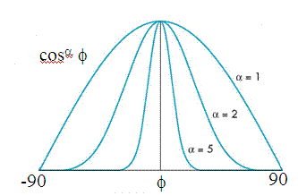
Specular Reflection
Reflectance determined by
Alignment of view vector with mirror reflection vector
Shininess coefficient
High coefficient means smoother look
Maybe 100 for metal
Maybe 20 for plastic

Slide 14

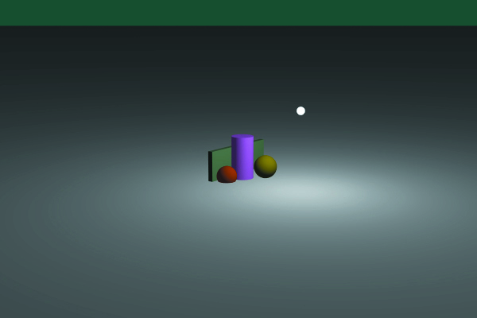
Point Lights
Which is attenuated? Why do both decrease with distance?

Slide 15
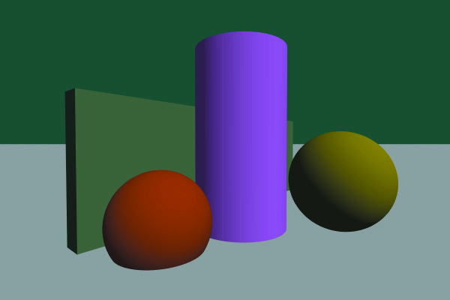
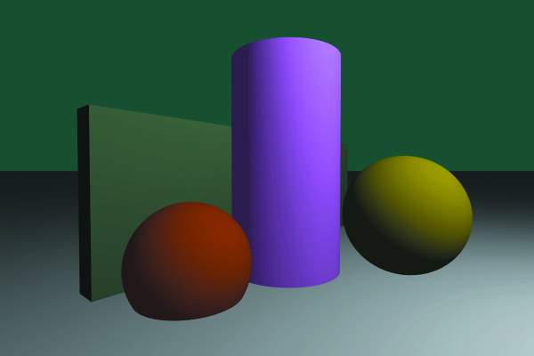
Comparison
Which is point and which is directional?

Slide 16
Out-of-Gamut Colors
Color values we can display are in [0,1]³
…but it’s possible for values to exceed 1
these are out of gamut colors
You can render in HDR and apply local tone-mapping
HDR=High Dynamic Range
Or you can clamp
Take largest value exceeding 1 and divide all channels by it
Maintains the hue

Slide 17
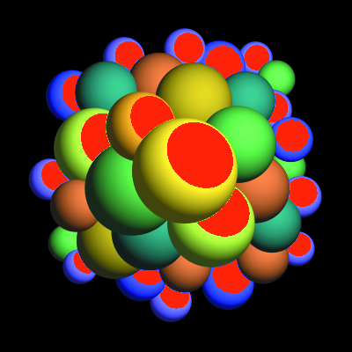
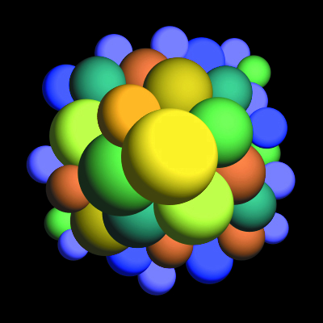
Out-of-Gamut Colors

